Slide 1
Bridges
By: Alison

Slide 2
Facts:
Bridges are massive static structures that carry roads and railroads over rivers, canyons, and other obstacles.
Different types of bridges are chosen depending on what they will carry, what they will cross, and the geological nature of Earth beneath them.
Often miles long and taking years to construct, bridges are triumphs of engineering over the environment the true wonders of the modern world

Slide 3
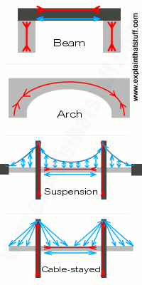
Here are the types of Bridge.
Beam, Arch, Suspension and Cable Stayed

Slide 4
What are Suspension Bridges?
A suspension bridge is a type of bridge in which the deck is hung below suspension cables on vertical suspenders. The first modern examples of this type of bridge were built in the early 19th century.
This type of bridge has cables suspended between towers, plus vertical suspender cables that carry the weight of the deck below, upon which traffic crosses. This arrangement allows the deck to be level or to arc upward for additional clearance.
The suspension cables must be anchored at each end of the bridge, since any load applied to the bridge is transformed into a tension in these main cables. The main cables continue beyond the pillars to deck-level supports, and further continue to connections with anchors in the ground. The roadway is supported by vertical suspender cables or rods, called hangers. The road may proceed directly to the main span, otherwise the bridge will usually have two smaller spans, running between either pair of pillars and the highway, which may be supported by suspender cables or may use a truss bridge to make this connection.

Slide 5
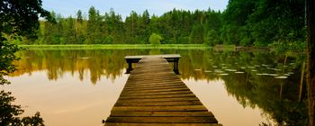
Other kinds of bridges.
Beam bridges – Very basic type of bridges that are supported by several beams of various shapes and sizes. They can be inclined or V shaped. Example of beam bridge is Lake Pontchartrain Causeway in Louisiana.
Arch bridges – These bridges uses arch as a main structural component. They are made with one or more hinges, depending of what kind of load and stress forces they must endure. Examples of arch bridge are “Old Bridge” in Mostar, Bosnia and Herzegovina and The Hell Gate Bridge in New York.
Cable-stayed bridges – Bridge that uses deck cables that are directly connected to one or more vertical columns. Cables are usually connected to columns in two ways – harp design (each cable is attached to the different point of the column, creating harp like design of “strings” and fan design (all cables connect to one point at the top of the column).
Tied arch bridges – Similar to arch bridges, but they transfer weight of the bridge and traffic load to the top chord that is connected to the bottom cords in bridge foundation. They are often called bowstring arches or bowstring bridges.
Truss bridges – Very popular bridge designs that uses diagonal mesh of posts above the bridge. The two most common designs are the king posts (two diagonal posts supported by single vertical post in the center) and queen posts (two diagonal posts, two vertical pots and horizontal post that connect two vertical posts at the top).
Cantilever bridges – Similar in appearance to arch bridges, but they support their load not trough vertical bracing but trough diagonal bracing. They often use truss formation both below and above the bridge. Example of cantilever bridge is Queensboro Bridge in New York City.

Slide 6
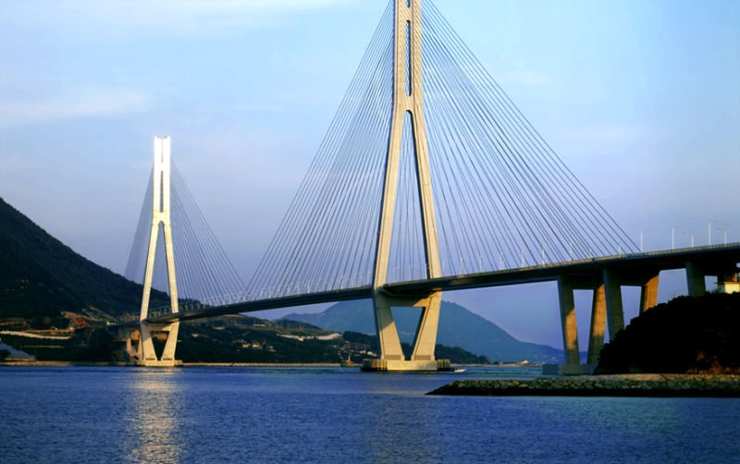
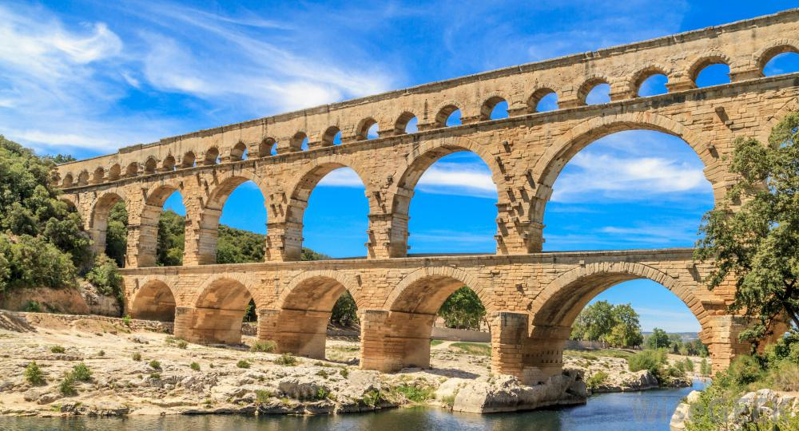
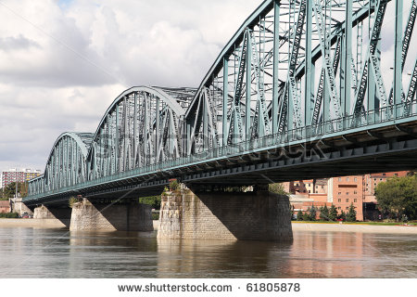
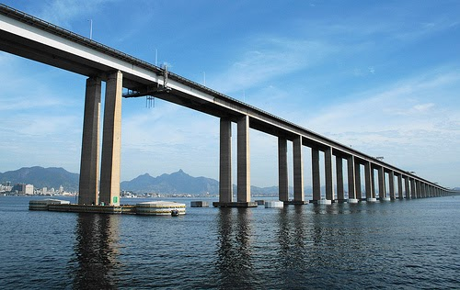
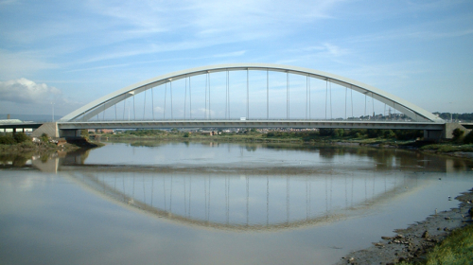
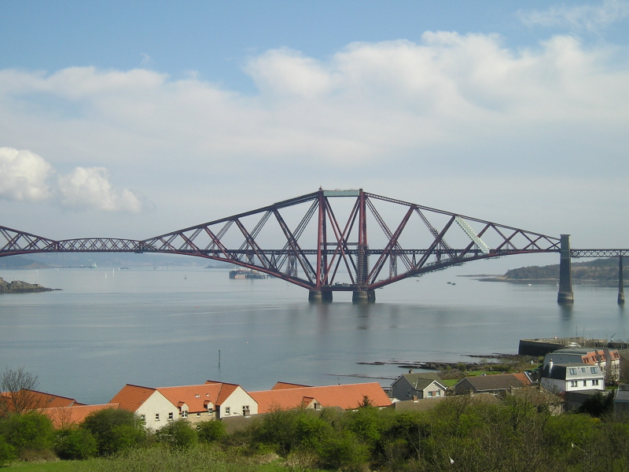

Slide 7
Fixed or Moveable Bridges:
Fixed – Majority of bridges are fixed, with no moveable parts to provide higher clearance for river/sea transport that is flowing below them. They are designed to stay where they are.
Moveable – They have moveable decks, most often powered by electricity.
Temporary bridges – Bridges made from modular basic components that can be moved by medium or light machinery. They are usually used in military engineering or in circumstances when fixed bridges are repaired.

Slide 8
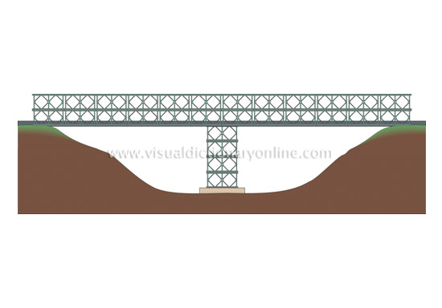
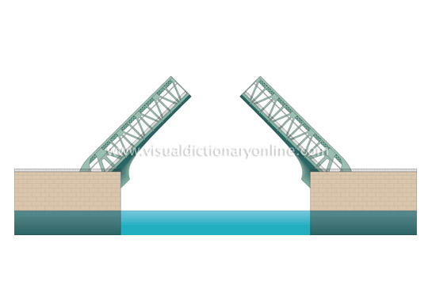

Slide 9
THE END
THANKS FOR WATCHING!!!!!

