Slide 2
What is Covid 19?
Covid 19 is the short way of saying coronavirus disease 2019.
It is a new virus and doctors are still learning about it.

Slide 3
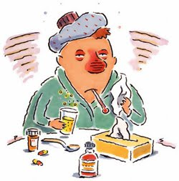
COVID- 19 is like having a flu.
People get a fever, cough, or have a hard time taking deep breaths.
Most people who have gotten COVID-19 have not gotten very sick.
Only a small group of people who get it have had more serious problems and need to go to hospital.

Slide 4
This virus is making a lot of people sick all over the world and here in Ireland.
Doctors and nurses are working very hard to help people stay healthy.

Slide 5
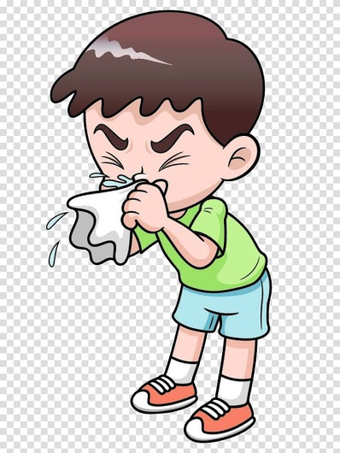
What can I do to help?
I can practice healthy habits at home.
I will cough and sneeze into a tissue or my elbow, if I do not have a tissue.
If I sneeze into a tissue, I will throw it into the bin straight away.

Slide 6
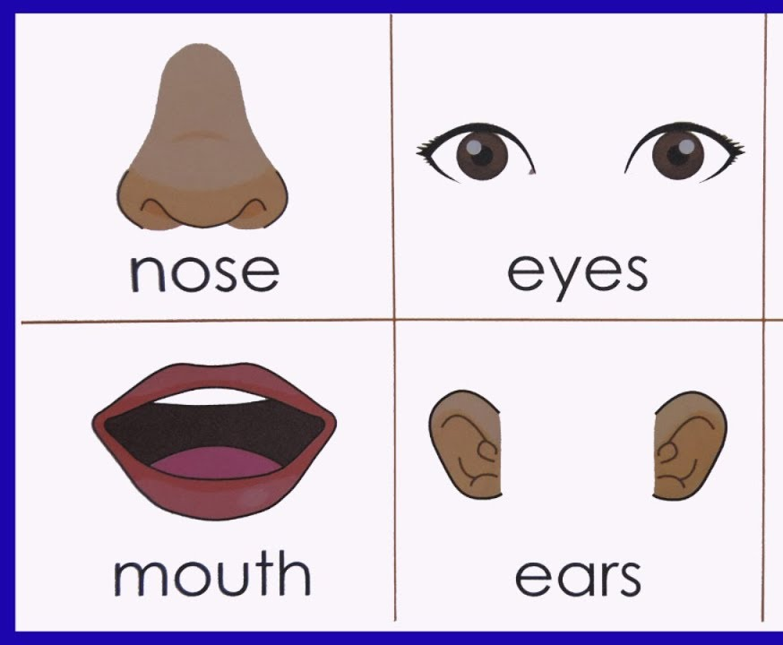
I will keep my hands away from my face.
I will keep my hands out of my mouth, nose and eyes.
This will help keep germs out of my body.

Slide 7
I will wash my hands with soap and water for at least 20 seconds.
Wet my hands with water.
Using soap make a lather or bubbles by rubbing my hands together.
Scrub the front and back of my hands and in between my fingers.
Rinse off my hands with water and dry them.

Slide 8
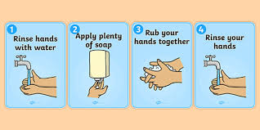
It’s important to wash my hands after playing outside, after I cough or sneeze and before and after meals or snacks. I will always wash my hands after I use the toilet.

Slide 9
To stop this virus spreading the government and doctors have asked us to stay out of school so that we do not spread germs to others.
This means I will do my school work at home for a little while.

Slide 10
We have been asked to keep our distance from others. This is called social distancing, we have to try keep our distance from others when we are at the shop, waiting in a queue or out for a walk .

Slide 11
I need to remember:
To wash my hands.
Sneeze/Cough into a tissue or my elbow.
Do my work at home.
Keep my distance from others.
Be Good For Mam and Dad.
Everything is going to be ok!

