Slide 1
TRICKY WORDS

Slide 2
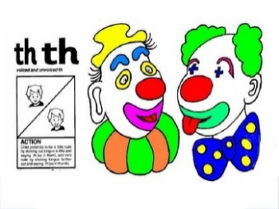
he | me
she | I
we | the

Slide 3
he | me
 | I
we | the

Slide 4
he | me
she | I
we | the

Slide 5
he | me
she | I
we

Slide 6
he | me
she | I
we | the

Slide 7
he
she | I
we | the

Slide 8
he | me
she | I
we | the

Slide 9
he | me
she | I
 | the

Slide 10
he | me
she | I
we | the

Slide 11
he | me
she
we | the

Slide 12
he | me
she | I
we | the

Slide 13
he
she | I
we | the

Slide 14
he | me
she | I
we | the

Slide 15
he | me
she | I
we

Slide 16
he | me
she | I
we | the

Slide 17
he | me
 | I
we | the

Slide 18
he | me
she | I
we | the

Slide 19
he
she | I
we | the

Slide 20
he | me
she | I
we | the

Slide 21
he | me
she | I
we

Slide 22
he | me
she | I
we | the

